Slide 1
Lead Score
Case Study
By
Ricky Chris Pinto
Tejas Thakur

Slide 2
Problem Statement
X Education sells online courses to industry professionals.
X Education gets a lot of leads, its lead conversion rate is very poor. For example, if, say, they acquire 100 leads in a day, only about 30 of them are converted.
To make this process more efficient, the company wishes to identify the most potential leads, also known as ‘Hot Leads’.
The company requires a model wherein it assigns a lead score to each of the leads such that the customers with higher lead score have a higher conversion chance and the customers with lower lead score have a lower conversion chance.

Slide 3
Solution Approach
Data Cleaning and data wrangling.
Handle the Nan values
Check for duplicates
Drop large %ge missing columns
Impute Outliers or remove them.
Exploratory Data Analysis
Univariate Analysis : value counts and variable distribution
Bivariate Analysis : correlation and pattern between variables
Variable scaling and Dummy variable creation
Creating Model : Logistic regression is used to build model and for predictions
Model Evaluation
Conclusion

Slide 4
Data Cleaning and Wrangling
From Dataset we have 9240 rows and 37 columns.
Dropping "Prospect ID" and "Lead Number" since these will not add any useful information.
Columns with more than 25% missing values are dropped.
We can also drop lead quality because its value is assigned based on "intuition of the employee" assigned to the lead and may cause bias. Lead quality can also be dropped as based on the levels of this categorical variable the information contained is very similar to lead quality and can be interpreted from other variables.
Dropping columns with irrelevant data for our analysis.

Slide 5
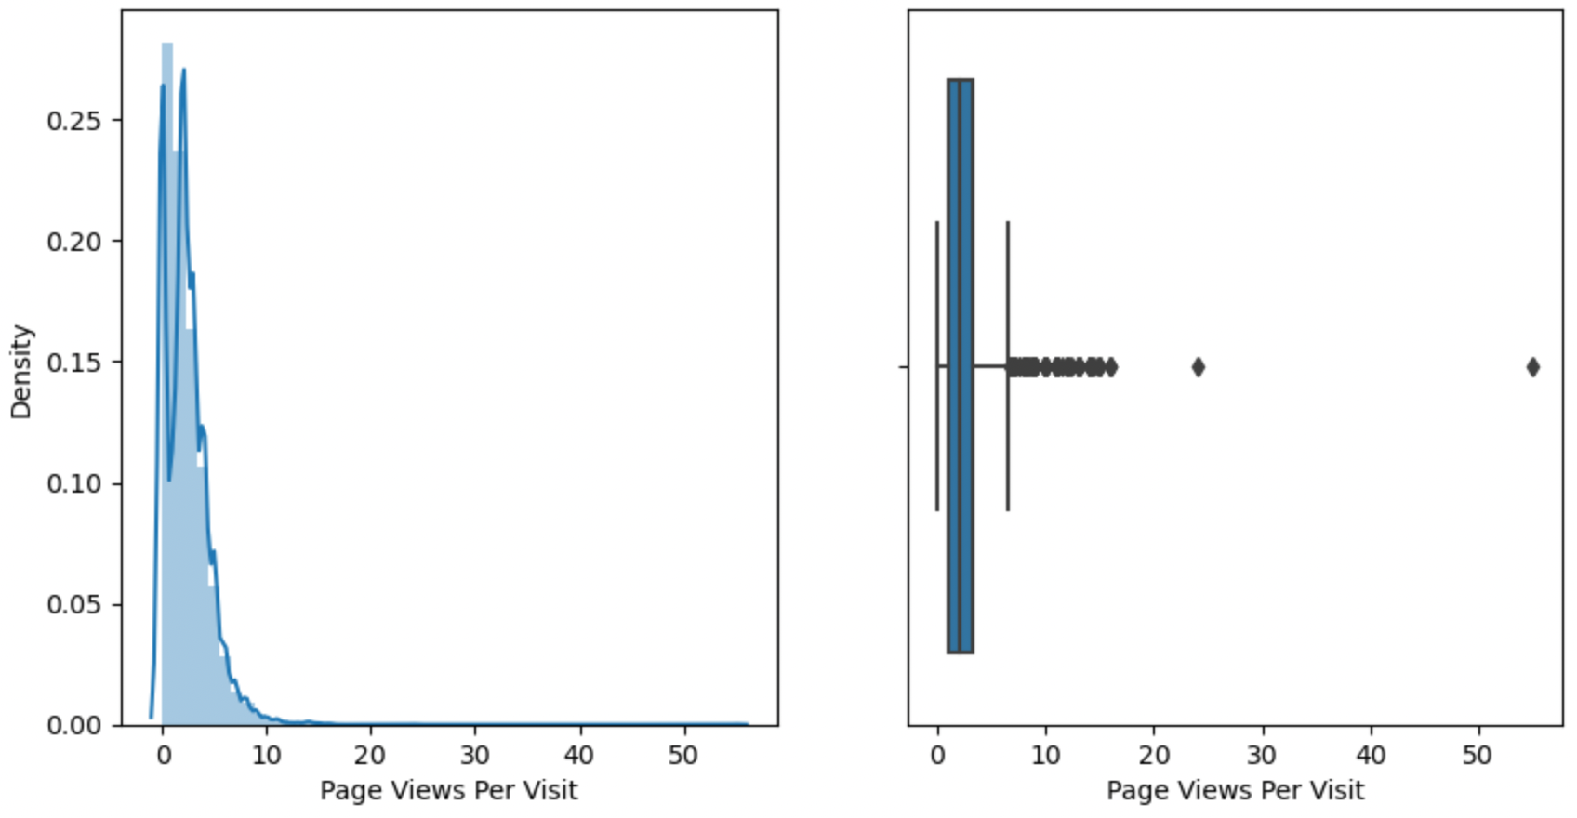
EDA
For Numerical Variables,

Slide 6
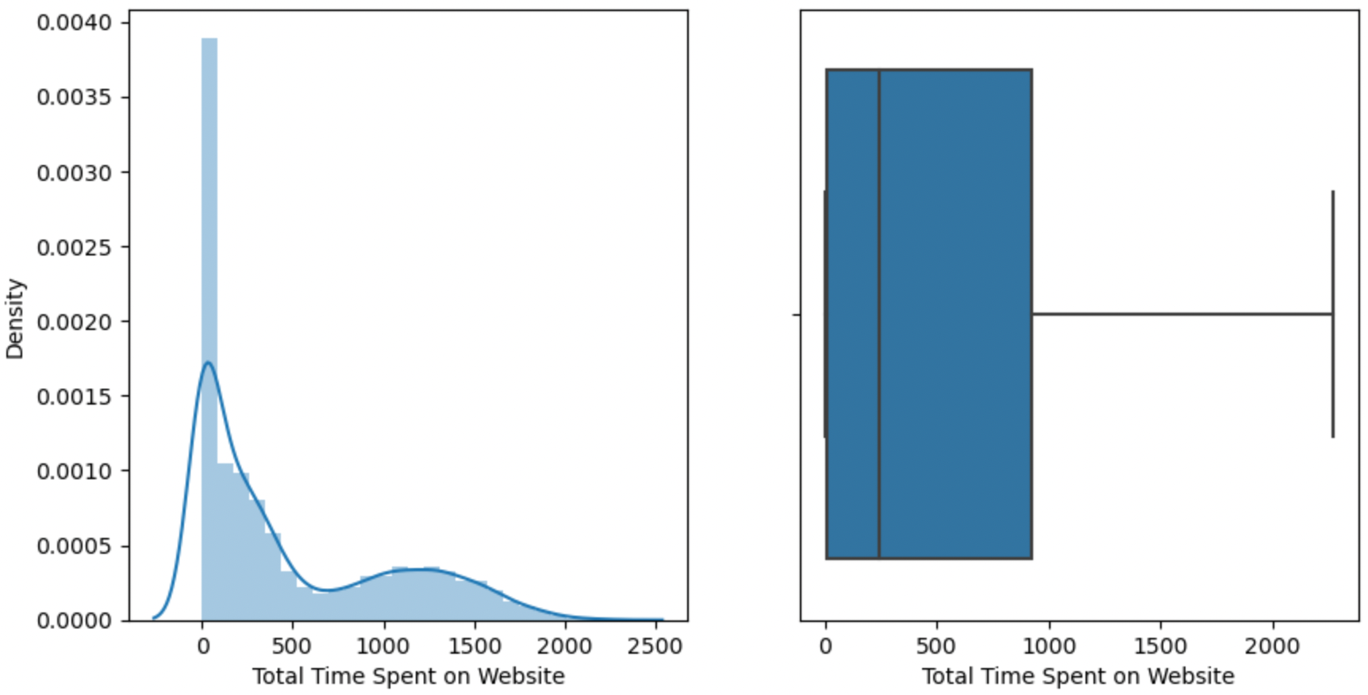

Slide 7
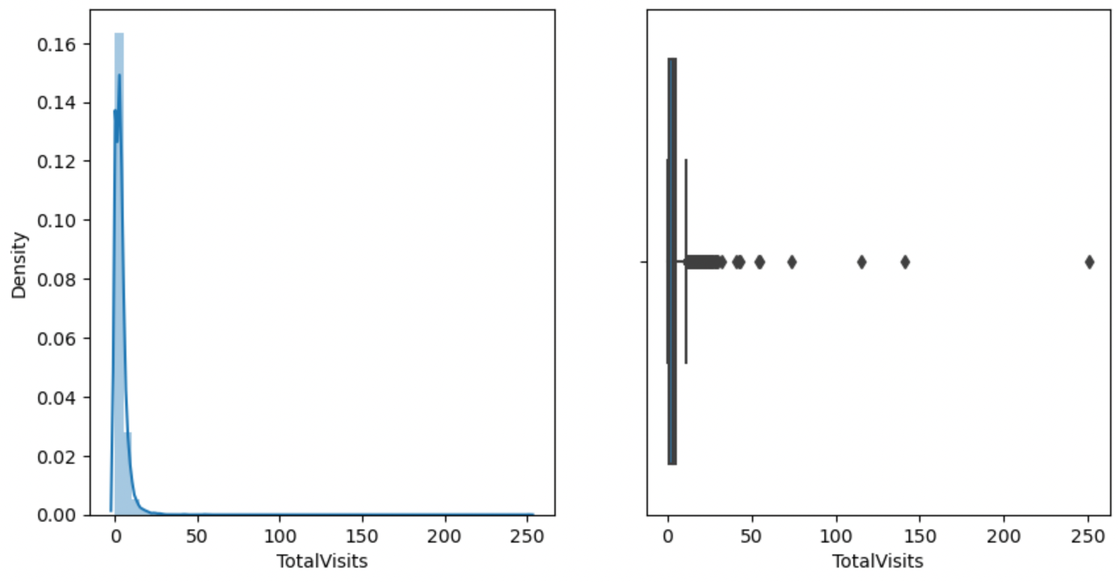

Slide 8
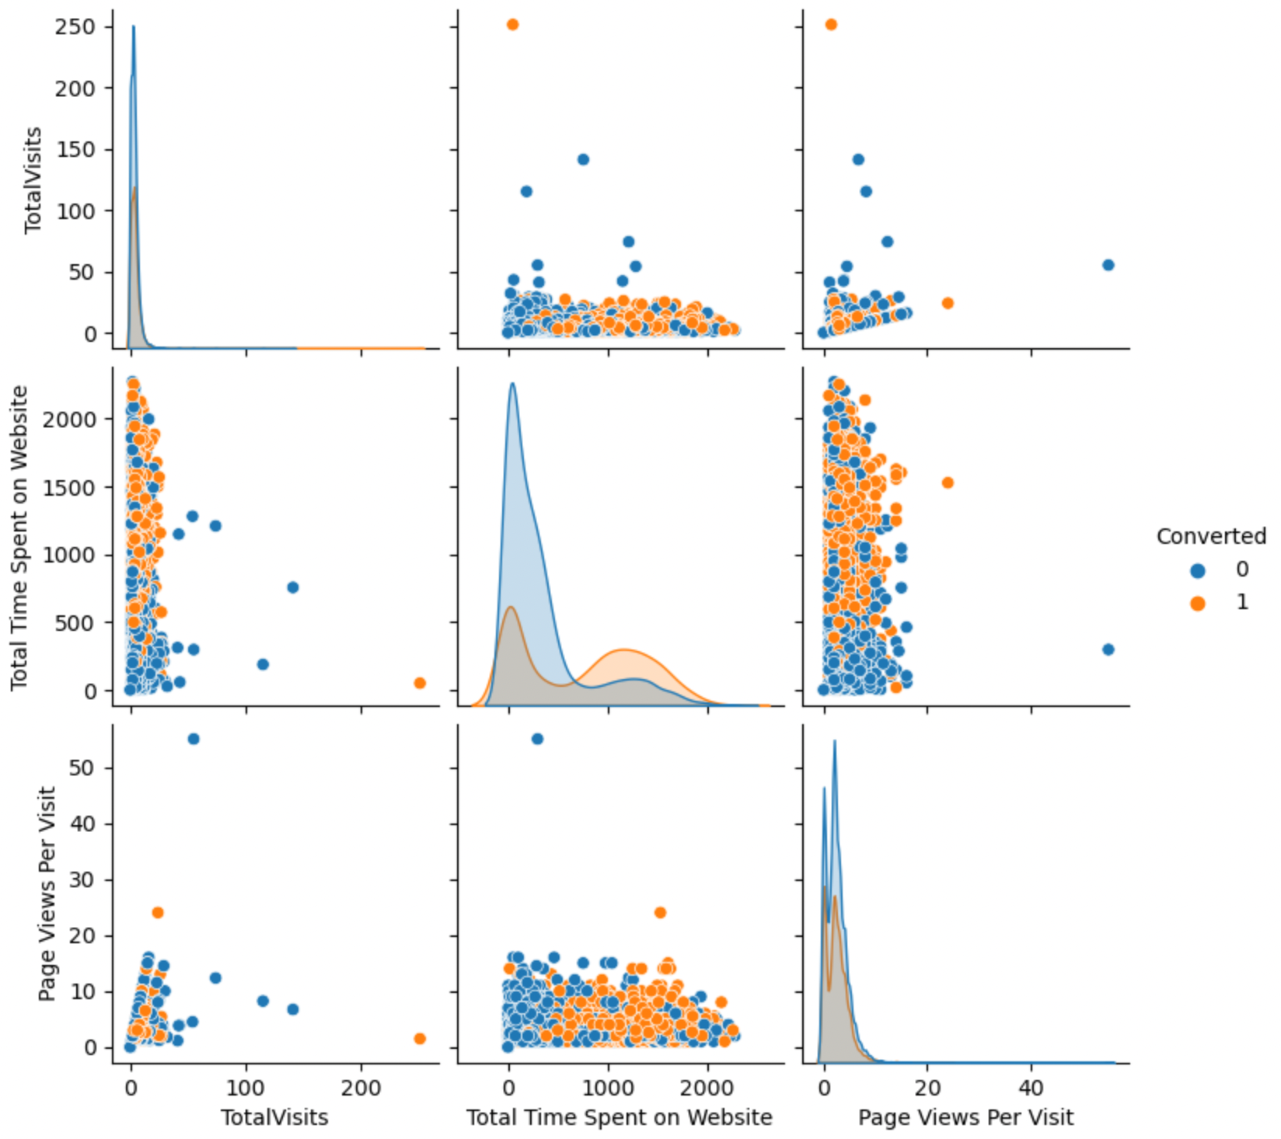
Bivariate Analysis

Slide 9
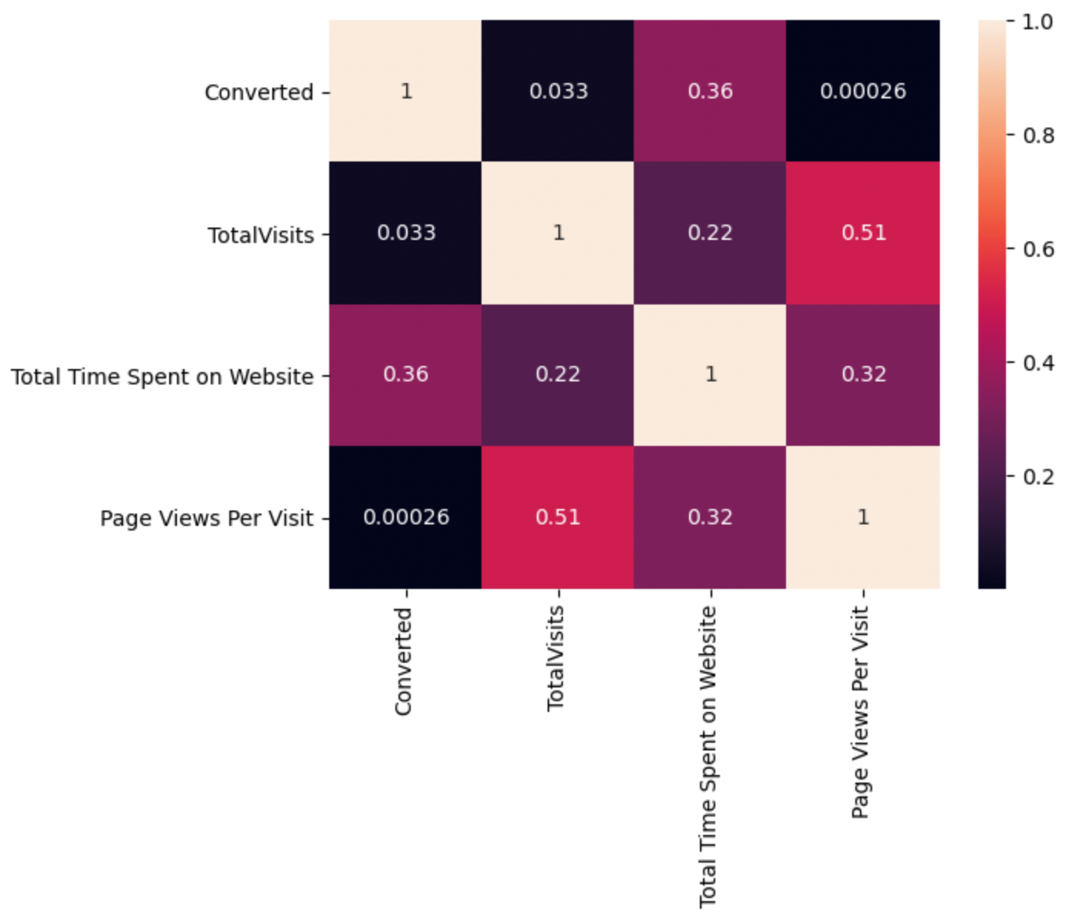

Slide 10
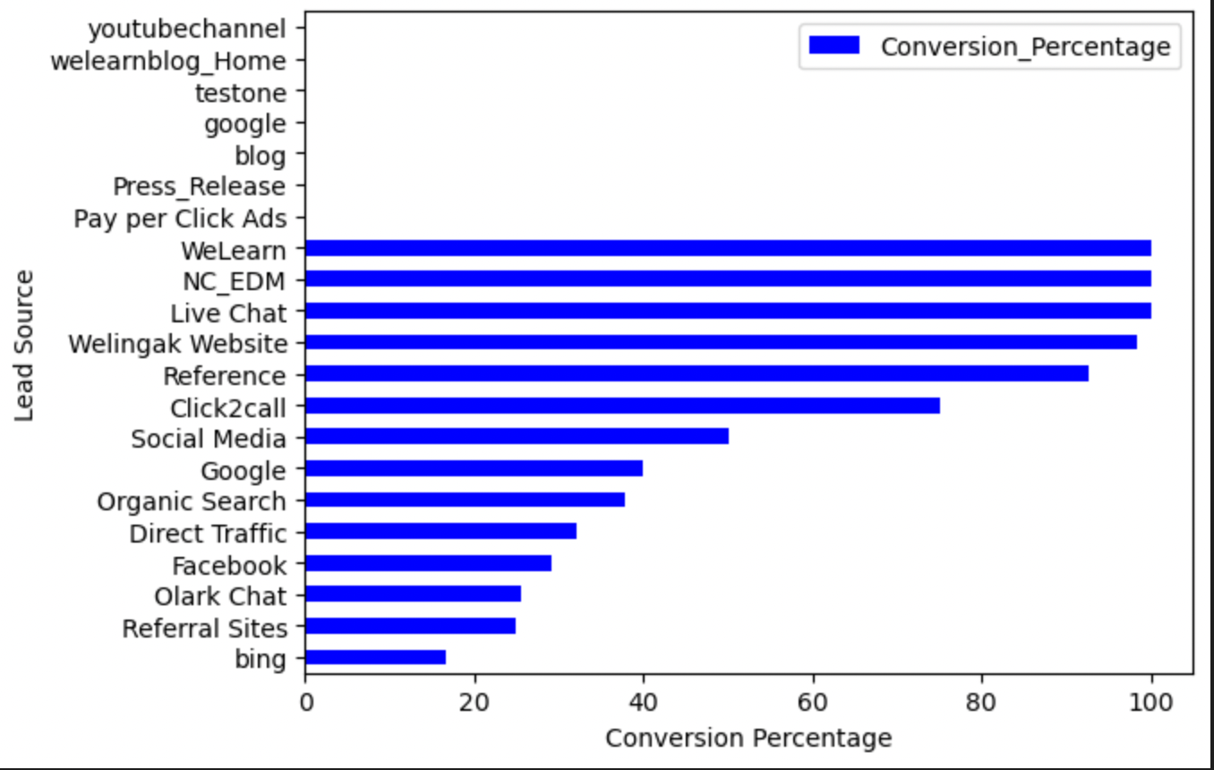
For
Categorical
Variables

Slide 11
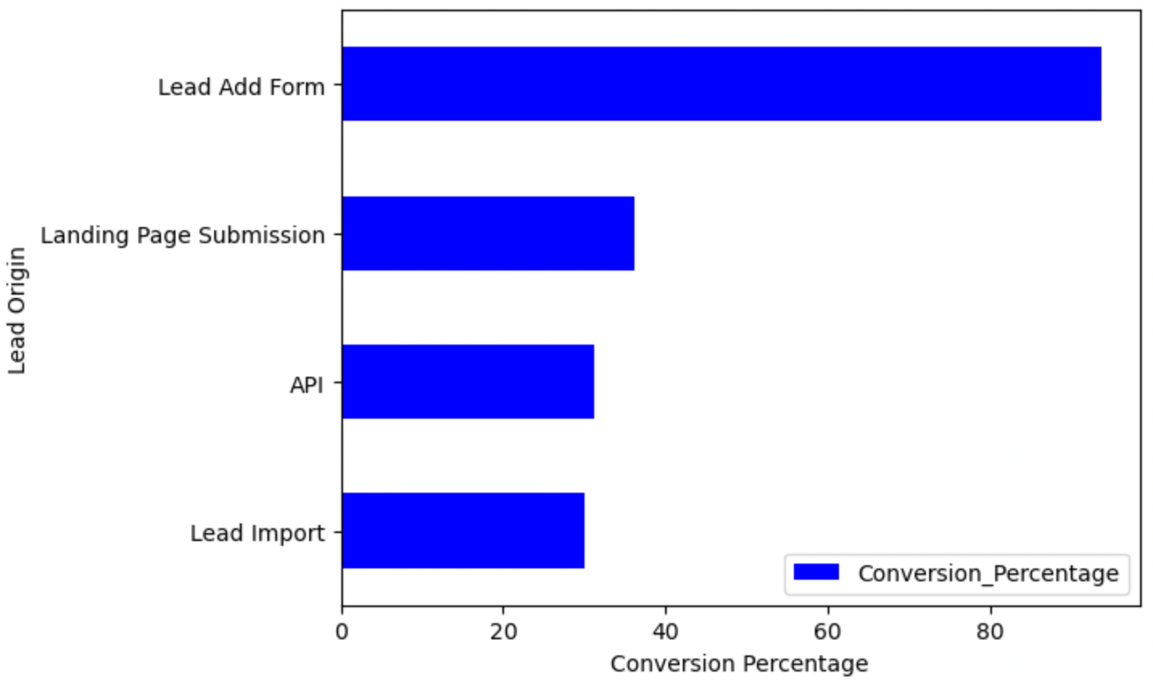

Slide 12
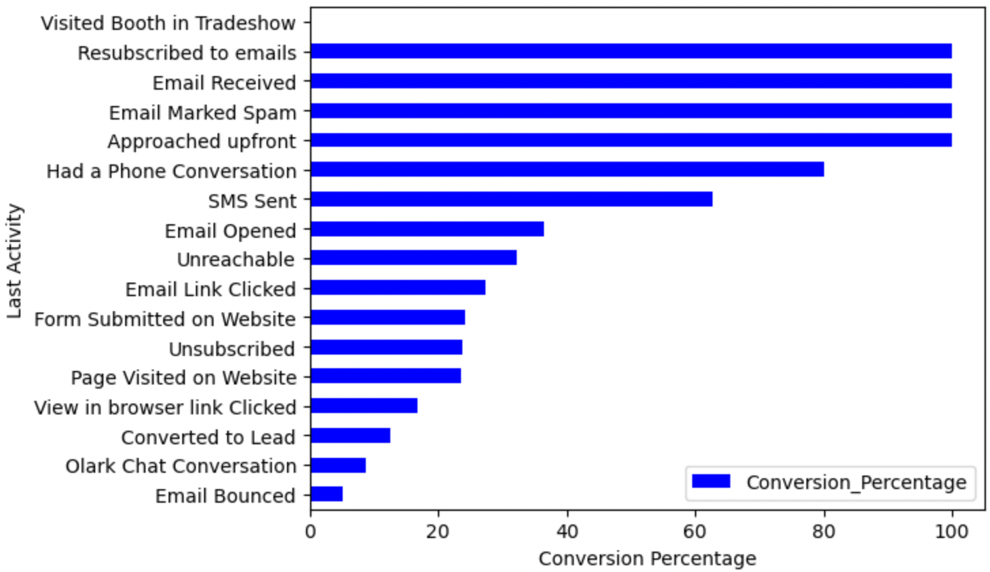

Slide 13
Data Imputations
Standardizing Numeric variables using MinMax Scalar.
Creating dummy variables for Object data type variables.
There are 6351 rows and 66 columns for the analysis after cleaning.

Slide 14
Model Building
Splitting the data into train and test data sets.
Perform test-train split with 70:30 ratio.
Use RFE for top feature selection.
From RFE we get 15 top variables.
Build the model.
Remove variables with high p values and VIF > 5.
Predict on Test data set.
Accuracy of the model is over 70%

Slide 15
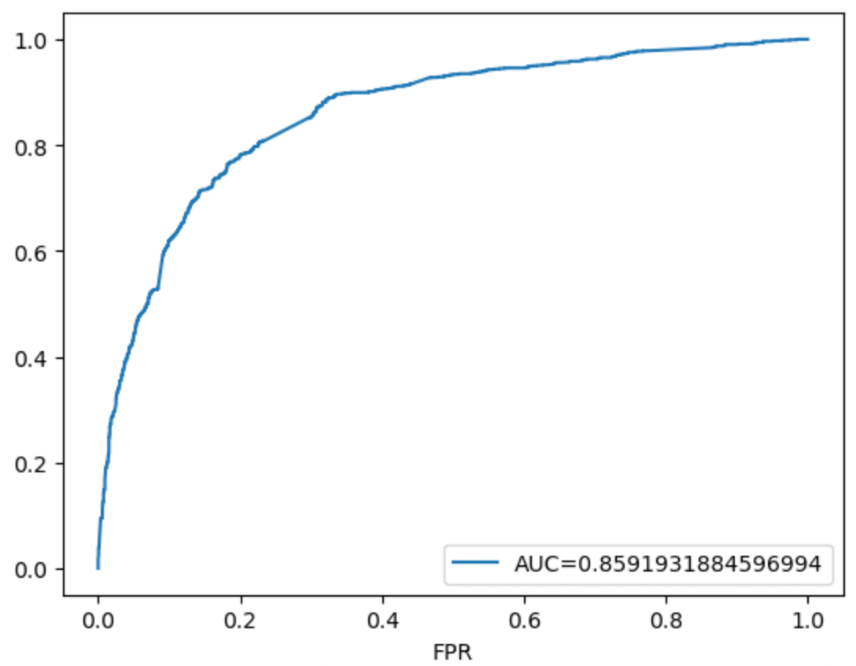
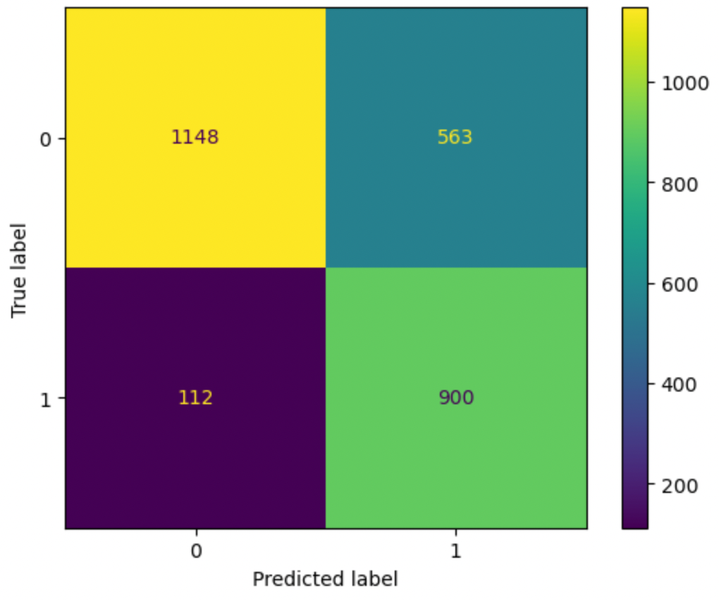
Model Evaluation:
ROC Curve
Confusion matrix

Slide 16
Conclusions
The Variables with high coefficient values as per the model are listed below:
Total Time Spent on Website
Lead Source
Welingak Website
Reference
Organic Search
Google
Direct Traffic
Last Activity
Had a Phone Conversation
SMS Sent
Olark Chat Conversation
Unreachable
Total Visits

